Slide 1

Scientific Literature Analysis In Neuroscience
Introduction to the Course
BIOENG-451
Academic year: 2023-2024
Teacher: Prof. Gioele La Manno
TA: Alessandro Valente

Slide 2
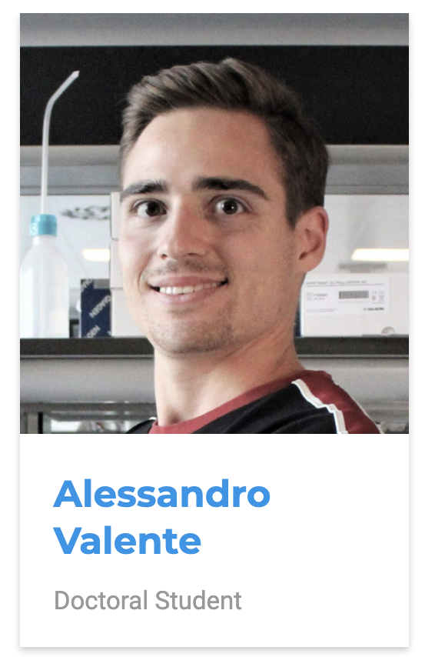


Contacts
MAIN CONTACT
alessandro.valente@epfl.ch
PROFESSOR CONTACT
gioele.lamanno@epfl.ch
MOODLE
https://moodle.epfl.ch/course/view.php?id=14338

Slide 3

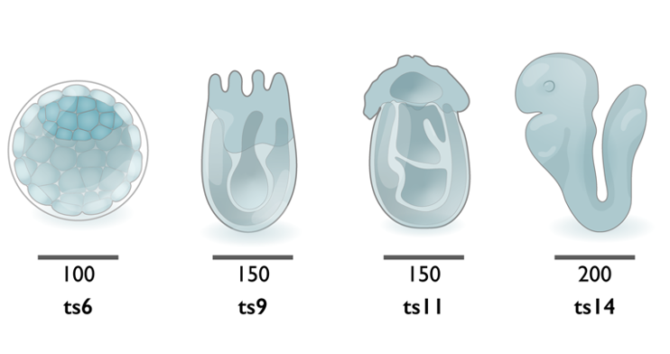
What is our goal?
Learn to…
analyze a scientific paper critically,
question if the data support the conclusions,
produce constructive referee reports in written or oral form.
The papers considered will give an overview of the field of
developmental neurobiology.

Slide 4
How we want to achieve it?
Atmosphere conductive to learning!
Caring about your own and your collogues participation and learning.
Honesty and transparency.
Any problems or doubt better if communicated early.

Slide 5
You will be able to…
Synthesize a scientific paper’s narrative.
Analyse its results and methodological approach.
Evaluate solidity of a papers’ claims with respect to the supporting evidence.
Critique its contributions in the context of neurodevelopment literature.
Express this analysis in oral and written form.
Extract and elaborate information from a publication, to achieve an objective beyond the original scope of the work.

Slide 6

Course schedule
PART 1 – Lecture-based learning Week 1 - Intro to the course + [Lecture 1] Critical paper reading Week 2 - [Lecture 2] Outline about neural development. Week 3 - [Lecture 3] Outline about scientific techniques and modeling human brain development. Week 4 – Mock JC and Preliminary discussion about Mini-projects.
PART 2 – Journal club-centered learning Week 4 - Papers 1-2 about Patterning and Gene Regulation Week 5 - Papers 3-4 about Patterning and Gene Regulation Week 6 - Papers 1-2 about Neurogenesis and Lineages Week 6 - Papers 3-4 about Neurogenesis and Lineages Week 7 - Papers 1-2 about Migration and Synaptogenesis Week 8 - Papers 1-2 about Single-cell analyses and computation Week 9 - Papers 3-4 about Single-cell analyses and computation Week 10 - Papers 1-2 about Human development and in vitro models
PART 3 – Mini-projects-centered learning Week 11 – Preliminary discussion/orientation projects Week 12 – Outline presentation Week 13 - Regroup on miniproject Week 14 - Projects Presentations

Slide 7
PART 2 – Journal Club
Two groups will run a journal club on two papers (Full Guidelines on MOODLE).
Typical weekly Effort: Detailed Read and Analysis of a research article. + Prepare your JC contribution + Read the other group research article

Slide 8
Structure
Journal Club – Format and Guidelines
Serial JC Discussion Each class/session revolves around the critical evaluation of two papers within one of the five topics the course revolves around. All participants are required to read both papers in advance.
Task Two separate groups are responsible for evaluating one paper each, and are aware of their designated paper prior to the session. No group work is expected before we meet in class.
Reference Material Other than the papers, for each topic we provide 2-3 literature reviews reading them is not assessed in any way but are just suggested them to support your awareness of the field, improve your understanding of the papers and enrich the JC discussion.

Slide 9
Roles within each group
Journal Club – Format and Guidelines
Presenter (x1) Initiates the session with a PowerPoint presentation, summarizing key points and sparking discussion.
Moderator (x1) Ensures that the 30-minute discussion flows smoothly and that all Discussants contribute. Concludes with a 2-minute wrap-up summarizing the session's major takeaways.
Discussants (others) Six members actively contribute to the discussion, supported by their prepared analyses and questions.

Slide 10
Timing and Flow
Journal Club – Format and Guidelines
15-Minute Presentation The designated Presenter initiates the discussion with a 15-minutes long presentation.
30-Minute Discussion Facilitated by the Moderator, this segment aims to be an engaging conversation among the Discussants and the class. The Moderator ensures that all evaluated Discussants contribute questions or criticisms during this time.
2-Minute Wrap-up The Moderator succinctly summarizes the different opinions and viewpoints that emerged during the discussion.

Slide 11
Preparation
Journal Club – Format and Guidelines
Homework for Discussants Discussants are tasked with submitting a document each morning, answering four designated questions. The first is a general question common to all papers, and the remaining three are tailored to the specific paper being discussed.
Note on Grading Although the Presenter and the Moderator are not graded based on written reports, they are expected to delve deeply into the paper and its methods to facilitate an insightful discussion.
Inter-Group Interaction Students from the non-leading group are encouraged to ask comprehension-based questions, which the leading group is expected to address.

Slide 12
Evaluation Criteria for Journal Clubs
Presenter
Clarity of Presentation: While field-specific jargon is acceptable given the depth of discussion, terms and concepts should be well-explained for the benefit of all participants.
Adherence to Time: Strictly adhere to the 15-minute time frame to allow ample time for a rich discussion.
Ability to Summarize: Presenters must distill the paper’s core arguments, methods, and findings in a focused manner.
Selection of Key Figures: Choose the most critical figures for discussion from the paper, as not all may fit into the limited presentation time. Merely copying and pasting numerous figures without adequate time for explanation is not acceptable.
Contextualization: Offer a brief background to set the paper in context, aiding in a more comprehensive understanding.
Critical Evaluation: Highlight at least one significant point of scientific criticism and one area where the paper lacks clarity.
Participation in Discussion: Remain actively involved during the discussion phase.
Response to Audience: Be equipped to answer questions from the audience, showcasing a deep understanding of the paper.

Slide 13
Evaluation Criteria for Journal Clubs
Moderator
Inclusive Discussion: Make sure all Discussants get an opportunity to share their views, either by directly inviting them to speak or by creating opportunities for them to interject.
Debating Skills: Exhibit the capacity to guide the conversation effectively, challenging any inaccuracies or questionable opinions.
Contextualization: Provide a brief background that sets the paper within its broader scientific landscape.
Open Questions: Be prepared to manage and respond to broader questions that may arise.
Methodological Details: Ensure that any questions regarding the paper's methodology are clearly and correctly addressed.

Slide 14
Evaluation Criteria for Journal Clubs
Discussants
Written Report [MORE IN DETAIL].
Active Participation: Engage in the discussion with at least two of the following contributions: thoughtful point, non obvious question, or criticism.
Depth of Understanding: Contributions should reflect a thorough understanding of the paper, adding nuance to the discussion.
Responsiveness: Adapt as needed, especially if a prepared question or point has been previously covered by another Discussant.
Thoughtful Engagement: Questions should go beyond the superficial, demonstrating a well-considered understanding of the paper’s content, methodology, and implications.

Slide 15
Written Reports
The written reports are integral to fostering a rich and nuanced discussion in our Journal Club.
These reports should be 350-500 words in length and structured around the responses to four key questions.
Composition and Structure
Length: The report should be within the range of 350-500 words to ensure depth without sacrificing focus.
Questions: The composition of the report will be facilitated by answering four questions (note: the report is really just about responding to the 4 questions and nicely collating them in a single coherent text). The questions will guide the content and structure. Please indicate the point in the text where you are starting to answer by writing e.g. [Q2]

Slide 16
Written Reports
Four Questions:
General Summary: The first question is constant for every paper and aims to stimulate a concise yet comprehensive summary of the paper. The question is:
"What are the key objectives, methods, and findings of this paper, and how do they contribute to the field?"
Methodological Understanding (Q2): This question will generally ask you to describe how a particularly complex display item (like a plot or a graph) is generated or what it represents. This gauges your understanding of the methods employed.
Weaknesses Identification (Q3): This question will prompt you to select a specific aspect of the paper that you find questionable or weak. This tests your ability to critically evaluate scientific work.
Interpretation and Opinion (Q4): You will be asked to choose between two possible interpretations or views concerning the paper's value or implications and to justify your choice. This evaluates your ability to think critically about the research's broader impact.

Slide 17
Written Reports
Evaluation Criteria
Clarity: Clear articulation of ideas and logical structure.
Pertinence: Relevance and context of the points or questions raised.
Understanding: Depth of comprehension of the paper's methodology and findings.
Accuracy of Criticism: Specificity and fairness in your critiques.
Originality: Innovation and critical thinking in the questions or criticisms posed.

Slide 18
PART 3 (more info will follow)
Mini-projects (group assigments) 2-3 people per group.
Mini-project A: Write a peer review of a biorxiv preprint article.
Mini-project B: Extract information to write a protocol from a paper as if you wished to replicate the data.
Mini-project C: Access the data from a paper and carry on a missing analysis which you expect could lead to an additional claim.

Slide 19
Questions?

